Slide 1
Native Americans of the Southeast: Cherokee ▪ Creek

Slide 2
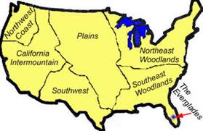
Southeastern Woodlands

Slide 3
Cherokee
The Cherokee (CHAIR-uh-kee) are a Native American tribe that lived in the Southeastern Woodlands.
A tribe is a group of people who share the same language, tradition and ancestors.
Cherokee tribes in Tennessee were located in East Tennessee.
Cherokee
Notes:
Cherokee did not live only in Tennessee. They lived in different parts of the southeastern United States.

Slide 4
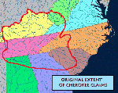
Where the Cherokee Lived in Georgia
Notes:
*A final note – speak of Georgia’s first people as respectfully, sincerely, & conscientiously as you would speak about your own ancestors. This website, http://www.native-languages.org/ymca.htm, originally written as a list of suggestions for a Native American theme-based community organization, has some very helpful hints for teaching about Native Americans. Some of the hints are not as relevant as others, but the author gives GREAT examples of ways to be sure that you are teaching about Native Americans accurately and respectfully.

Slide 5
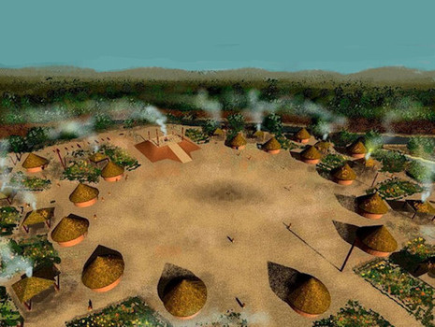
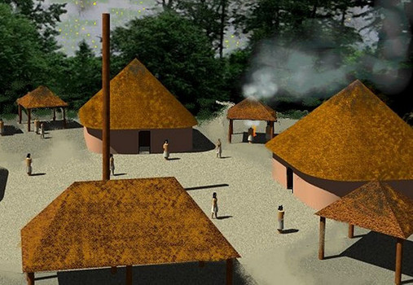
Cherokee
The Cherokee lived in small villages located near rivers.
A village is a small group of houses and the people who live there.

Slide 6
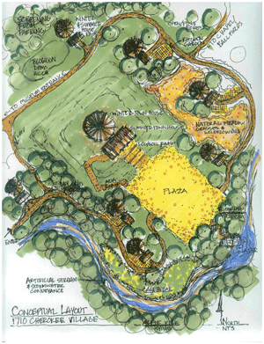
Cherokee Villages
Cherokee villages were located near rivers.
Most Cherokee lived in log cabins or earth lodges.
Cherokee villages had a circular Council House for meetings.

Slide 7
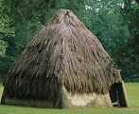
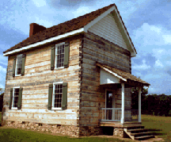
Cherokee Community Life
Division of labor between men & women
Active trading culture
Settled, farming communities
Removed to Oklahoma in 1838 – the Trail of Tears
New Echota
Cherokee Courthouse - Oklahoma
Notes:
This website links to a number of Native American languages. This particular page is a small glossary of words in Cherokee, with a linked pronunciation key: http://www.native-languages.org/cherokee_words.htm .

Slide 8
Cherokee Clans
Every Cherokee belonged to a clan.
A clan is a particular group of families that share a common ancestor.
There were 7 Cherokee clans: Wolf, Paint, Deer, Bird, Wild Potato, Blue, and Longhair.
People in a clan treated every member of the clan like brothers and sisters, even if they lived in a different village.
Notes:
At village meetings, each person sat with his or her clan. There were 7 clans: wolf, paint, deer, bird, wild potato, blue, and longhair. People in a clan treated other clan members as brothers and sisters, even if they lived in a different village.

Slide 9
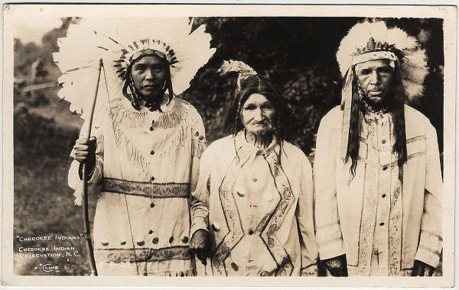
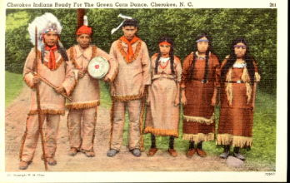
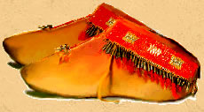
Cherokee Clothing
Cherokee wore clothing made from deerskin.
Men commonly decorated their bodies and faces with tattoos or paint.

Slide 10
Cherokee Daily Life
The Cherokee were farmers and hunters .
They grew corn, beans, and squash along with other crops.
Corn was their most important food.
The most important animal was the deer.

Slide 11
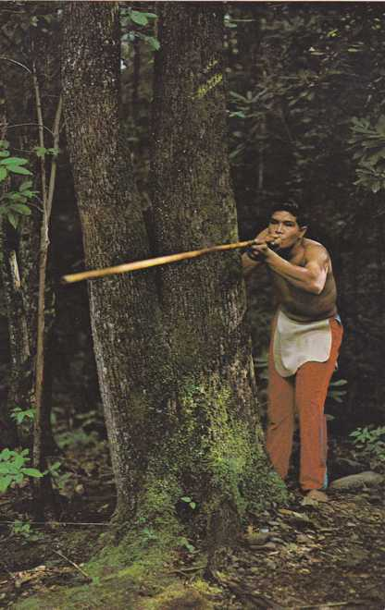
Cherokee Daily Life
Men taught boys how to make blow guns, darts, and weapons from flint.
Boys helped build cabins and carve canoes from wood.

Slide 12
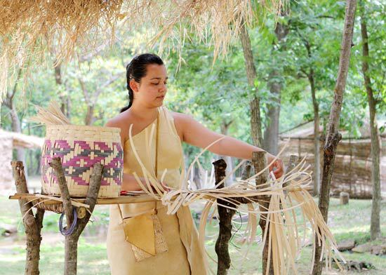
Cherokee Daily Life
Women taught girls how to make jewelry and cook.
Girls practiced weaving baskets from strips of wood.

Slide 13
Trail of Tears
Most Cherokees were forced to move to Oklahoma in the 1800's along the Trail of Tears.
Trail of Tears was the Cherokee name for what the Americans called Indian Removal.
Notes:
During the 1800's, the US government created an "Indian Territory" in Oklahoma and sent all the eastern Native American tribes to live there. Some tribes willingly agreed to this plan. Other tribes didn't want to go, and the American army forced them. The Cherokee tribe was one of the largest eastern tribes, and they didn't want to leave their homeland. The Cherokees were peaceful allies of the Americans, so they asked the Supreme Court for help. The judges decided the Cherokee Indians could stay in their homes. But the President sent the army to march the Cherokees to Oklahoma anyway. They weren't prepared for the journey, and it was winter time. Thousands of Cherokee Indians died on the Trail of Tears. Many Native Americans from other tribes died too. It was a terrible time in history.

Slide 14
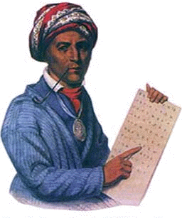
Sequoyah
One of the best-known people in Cherokee history is Sequoyah.
Sequoyah is also known as George Gist.
His mother was Cherokee, a member of the paint clan, and his father was white.
Sequoyah grew up in the village of Tuskegee, Tennessee and did not speak English.

Slide 15
Sequoyah
He became fascinated with the way the English communicated with written words.
Sequoyah called the English system of writing “talking leaves”.
Some say he used this name because he believed the white man’s words dried up and blew away like the leaves when they changed their minds.

Slide 16
Sequoyah
One day, Chief Charles Hicks taught Sequoyah how to write his name so he could sign his work like other silversmiths did.
Sequoyah wanted the Cherokee to be able to communicate and preserve their traditions through writings like the white man.
Sequoyah decided to create written words for the Cherokee language.

Slide 17
Sequoyah
At first he used Pictographs but realized that there would be thousands of symbols in Cherokee language.
Instead he decided to create symbols for each syllable the Cherokee spoke.
Over 12 years, Sequoyah invented about 85 characters for various Cherokee syllables.

Slide 18
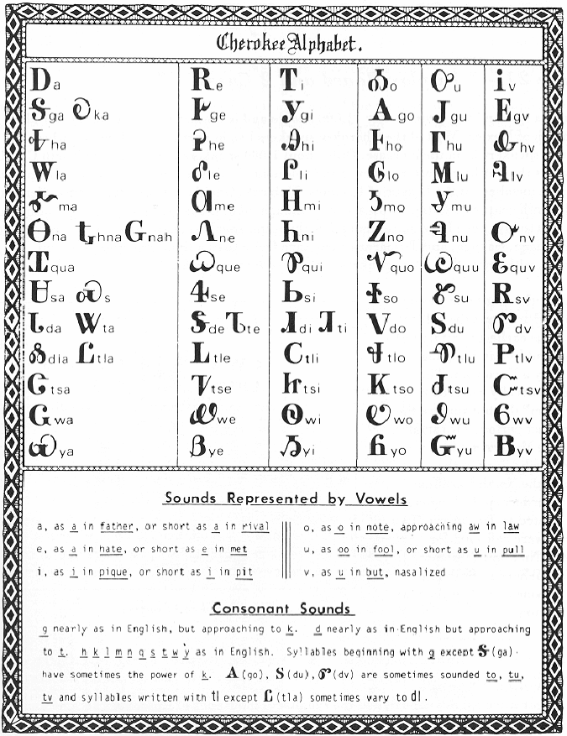
Sequoyah
Sequoyah’s system of written communication for the Cherokee language became known as Sequoyah’s Talking Leaves.

Slide 19
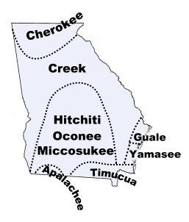
Creek
The Creek are a Native American tribe that lived in the Southeastern Woodlands.
The white settlers called them Creek Indians after Ocmulgee Creek in Georgia. They originally called themselves Isti or Istichata, but began to identify themselves as Muskogee soon after Europeans arrived.
Creek
Notes:
Tribes that lived on fertile farmland often established permanent settlements. Others lived a Nomadic lifestyle.

Slide 20
Southeastern Woodlands

Slide 21
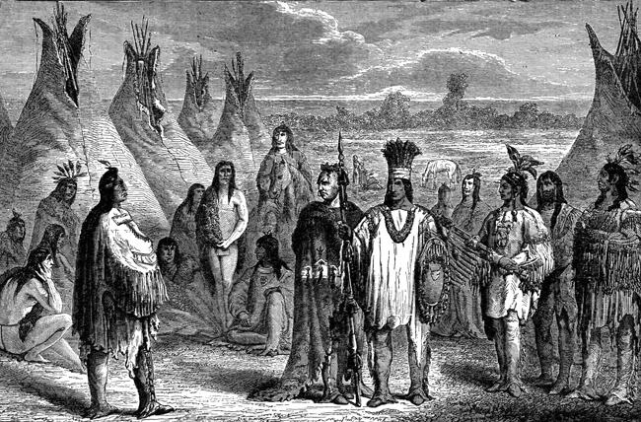
Creek
The Creek were originally called the Muscogee (muss-KOH-gee).
Muscogee is the original name for the Creek.
Today, many people use the two words together: Muskogee Creek
They are descendants of the Mississippi Mound Builders.
Like the Cherokee, they lived near rivers.

Slide 22
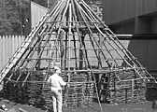
Creek Villages
At first, the Muscogee were a union of several tribes.
These tribes lived in settlements were called towns.
As the populations grew, new tribal towns grew out of “Mother towns.”
By the early 1800’s there were about 20,000 Muscogee living in 50 towns.

Slide 23
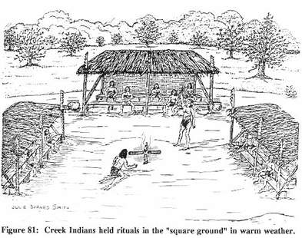
Creek Villages
Each town had a square, or plaza, for gathering together.
Ceremonies for peace, war and harvest time were all held in the square.
Some towns also had a temple built on an eight foot high earth mound.

Slide 24
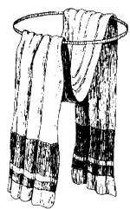
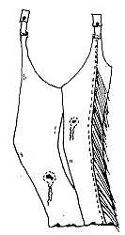
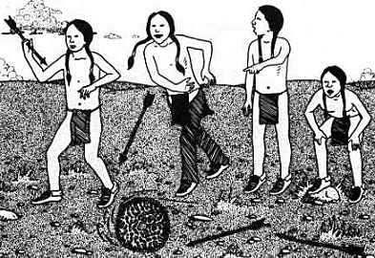
Creek Clothing
Creek men wore breechcloths and leggings. Creek women wore wraparound skirts and mantles made of deerskin or woven fiber. Creek men did not originally wear shirts, but both genders wore cloaks in cooler weather. The Creeks also wore moccasins on their feet.

Slide 25
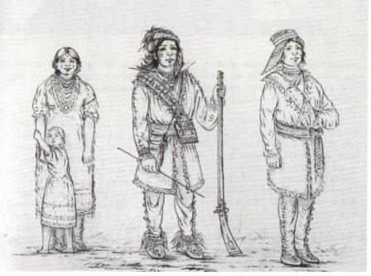
Creek Roles
Creek men were hunters and sometimes went to war to protect their families. Creek women were farmers and also did most of the child care and cooking. Both took part in storytelling, artwork and music, and traditional medicine. In the past, the chief was always a man, but today a Creek woman can participate in government too.

Slide 26
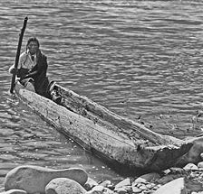
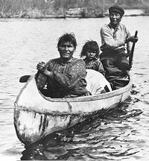
Transportation
The Creek Indians made long dugout canoes from hollowed-out cypress logs. Over land, the Muskogees Creeks used dogs as pack animals. (There were no horses in North America until colonists brought them over from Europe.)

